Slide 1
Microsoft 365 Enterprise
Licensing overview
December 2020
Latest diagrams available here:
https://github.com/AaronDinnage/Licensing

Slide 2
Latest diagrams available here: https://github.com/AaronDinnage/Licensing

Slide 3
Latest diagrams available here: https://github.com/AaronDinnage/Licensing

Slide 4
Latest diagrams available here: https://github.com/AaronDinnage/Licensing

Slide 5
Latest diagrams available here: https://github.com/AaronDinnage/Licensing

Slide 6
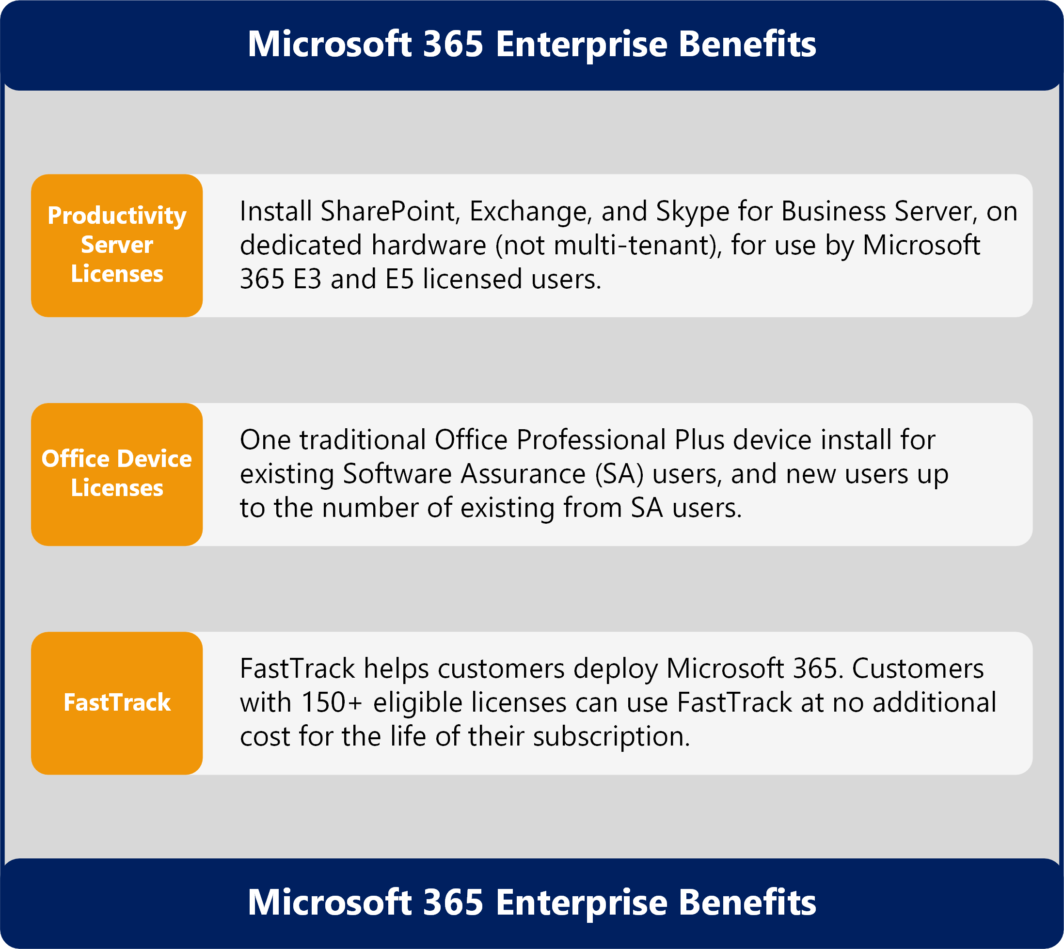
Microsoft 365 Benefits and Related Services
Latest diagrams available here: https://github.com/AaronDinnage/Licensing

Slide 7
Content on GitHub https://github.com/AaronDinnage/Licensing Updates on Twitter and LinkedIn https://twitter.com/AaronDinnage https://www.linkedin.com/in/aarondinnage/

